Slide 1
Now that you know Scratch, let’s start Python
Search repl.it

Slide 2
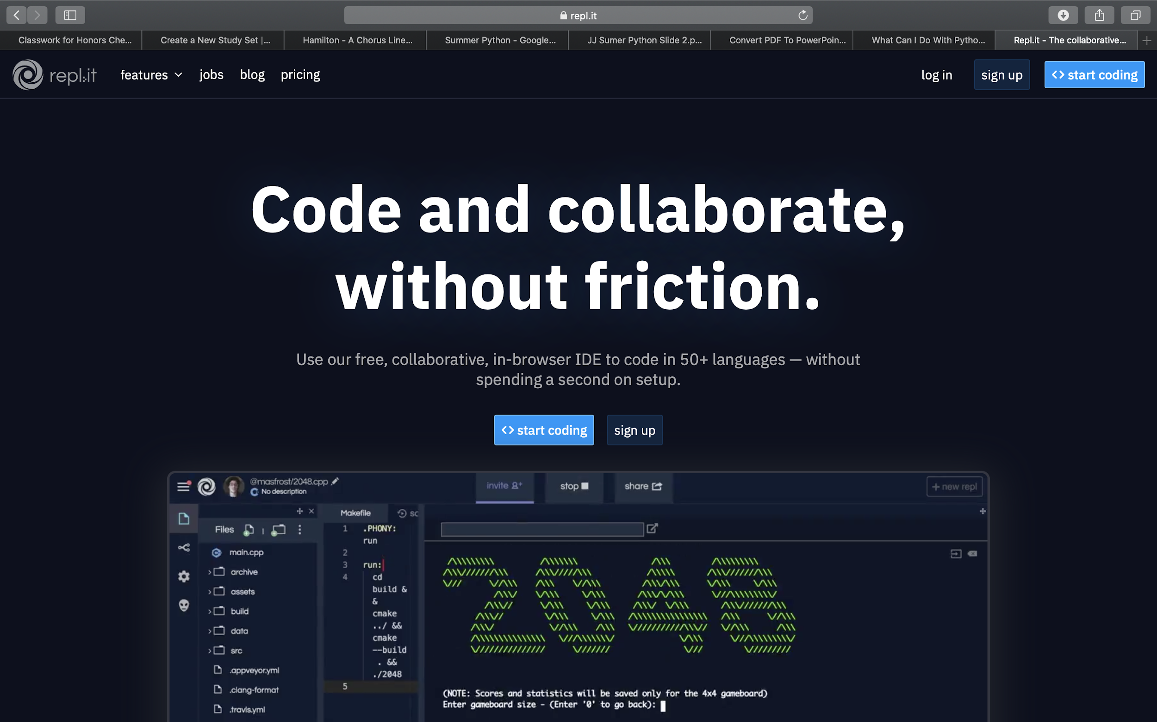
You should reach this page if you search repl.it
Repl.it is a cool site where you get to write code

Slide 3
Click
Sign
Up

Slide 4
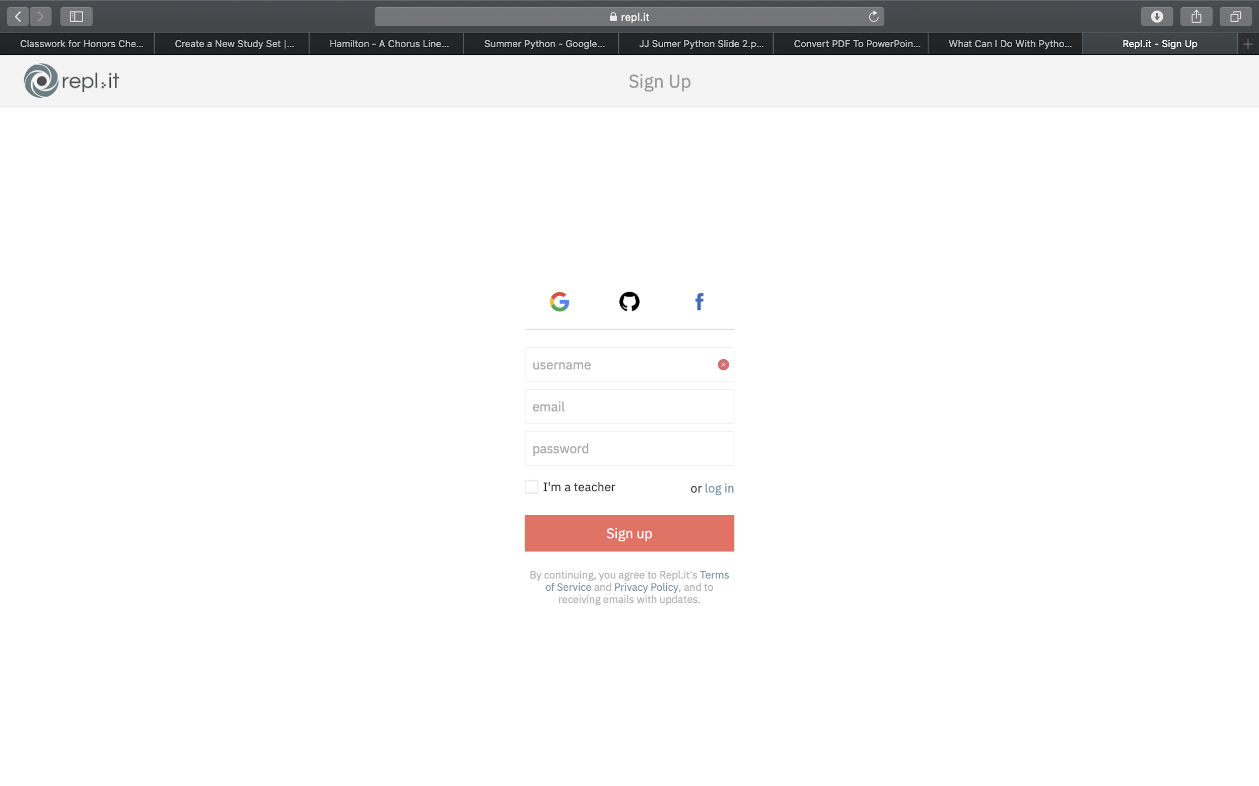
Click on the Google Sign up

Slide 5
Sign up using your school email address
Once you sign up, wait before you move on
The next part is really important

Slide 6
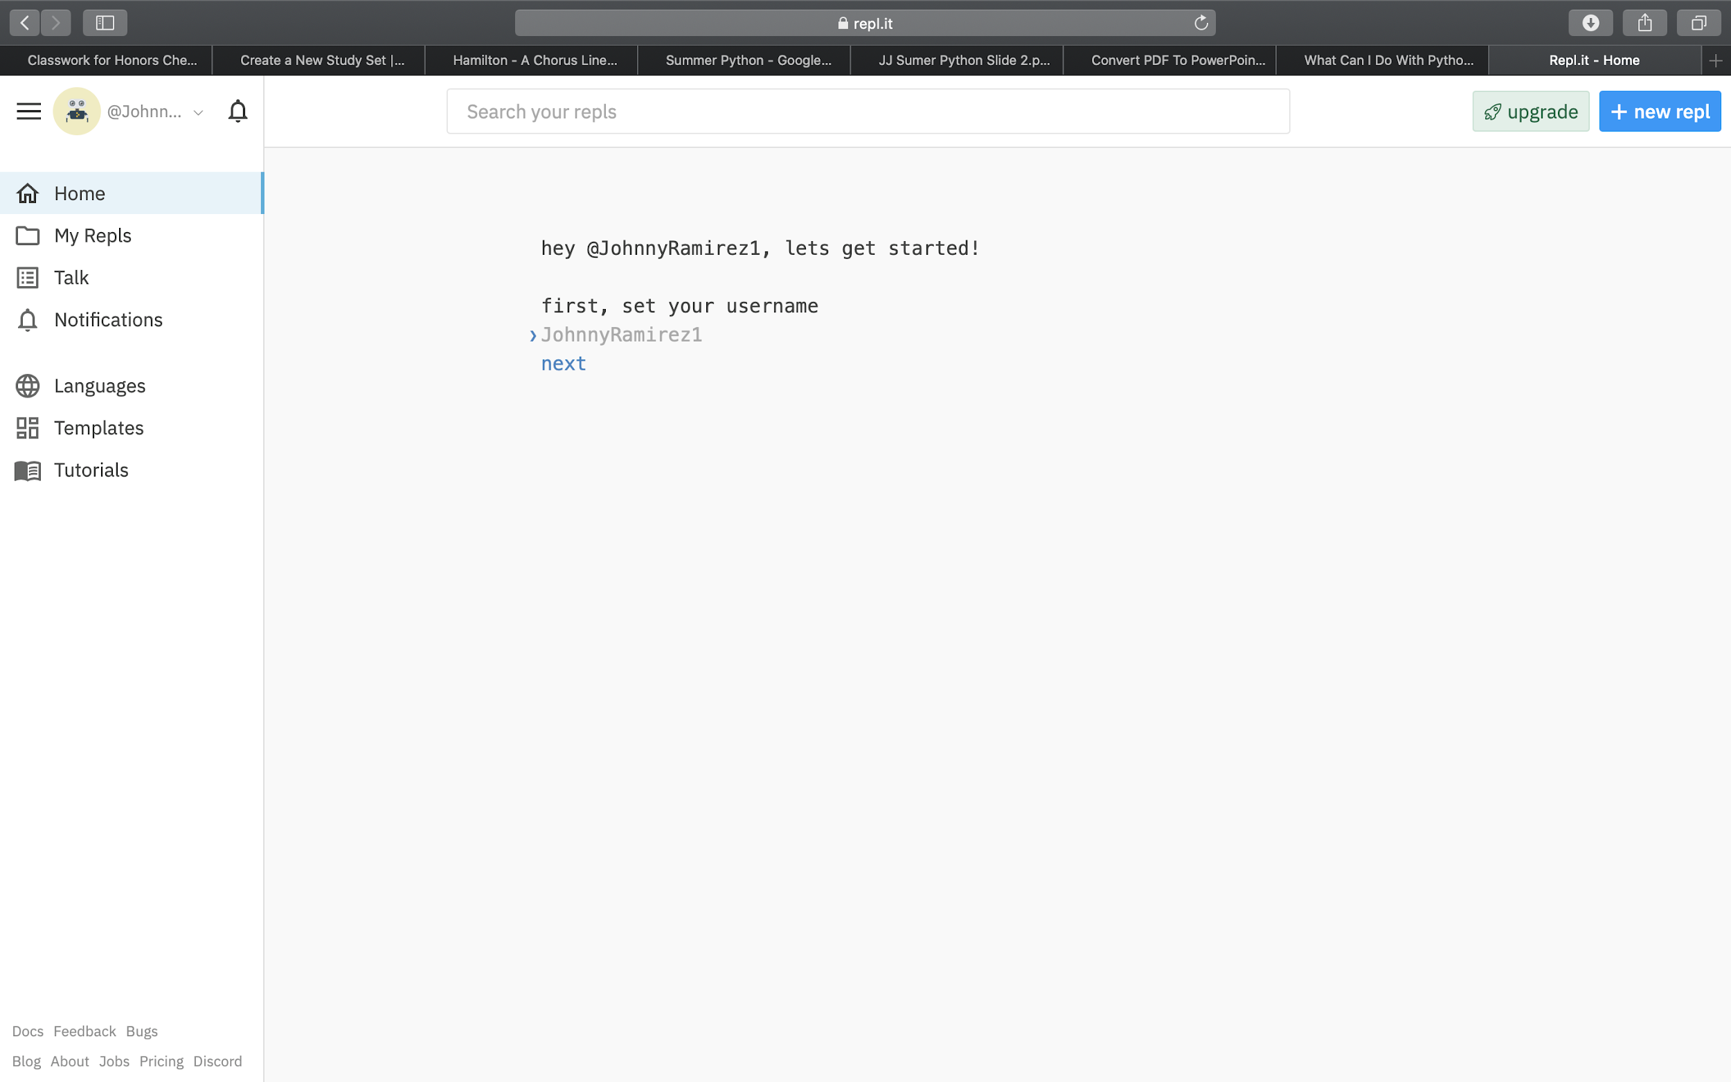
Create a username and share it with your advisor
Set your username when you reach this page.
Save your username

Slide 7
After sharing your username, answer the next few questions.
If you don’t know how to answer, here’s some help:
Email Question: Click Yes
Skill Level Question: Click “Brand New”
What you are most interested in:
Click “Learning” and then click “In a school”
Language Question: Click “Python” and two others languages (you can pick, it doesn’t matter which)

Slide 8
When you finish answering all of the questions, you will get a url sent to you by one of the advisors.
(during the session)
Click on it
You are about to write in Python!!!

